Slide 1


Robust Image Watermarking with Cross-Attention and Invariant Domain Learning
This presentation explores a novel image watermarking methodology that leverages cross-attention and invariant domain learning to enhance robustness and generalization. We will delve into the design of a new watermark embedding technique and the concept of learning an invariant domain representation for improved resilience against distortions.
by PAVAN ARAVAPALLI

Slide 2
Introduction to Digital Image Watermarking
Purpose
Deep Learning's Role
Digital image watermarking subtly embeds information within images to safeguard intellectual property, including content authentication, copy control, and copyright management.
Deep neural networks offer a promising alternative by learning generalizable complex mappings, mitigating challenges faced by traditional methods. This approach provides a more robust and efficient solution for protecting digital assets across various media, including images, audio, and video.
Traditional methods often require manual design, which is labor-intensive and may not yield optimal results for varying watermarks and distortions.

Slide 3




Advancements in Watermark Embedding
CNN Limitations
Vision Transformers (ViTs)
Prevalent deep learning methods use CNNs to extract features and concatenate them for watermarked image generation. However, CNNs excel in local feature extraction, which can limit their effectiveness for comprehensive image understanding.
ViTs are more adept at tasks requiring a comprehensive understanding of an image's content due to their ability to grasp global contextual information through attention mechanisms. This global perspective can lead to more coherent and effective watermarking.
Robustness Challenges
The integrity of extracted watermarks can be compromised by distortions. Current solutions often incorporate conceivable distortions into the training pipeline, limiting robustness to only those specific distortions.

Slide 4




Proposed Scheme: Cross-Attention and Invariant Domain
Multi-Head Cross Attention
We devise a watermark embedding technique using a multi-head cross-attention mechanism. This facilitates information exchange between the cover image and watermark to identify semantically suitable embedding locations.
Invariant Domain Learning
We propose learning an invariant domain that encapsulates both semantic and noise-invariant information regarding the watermark. This is achieved through a self-supervised watermarking framework that concurrently learns watermarking and the invariant domain.
Enhanced Robustness
This exploration in training methodology lays the groundwork for enhancing robustness in deep learning-based image watermarking. Experimental results show our method matches or surpasses state-of-the-art techniques in various noise scenarios.

Slide 5
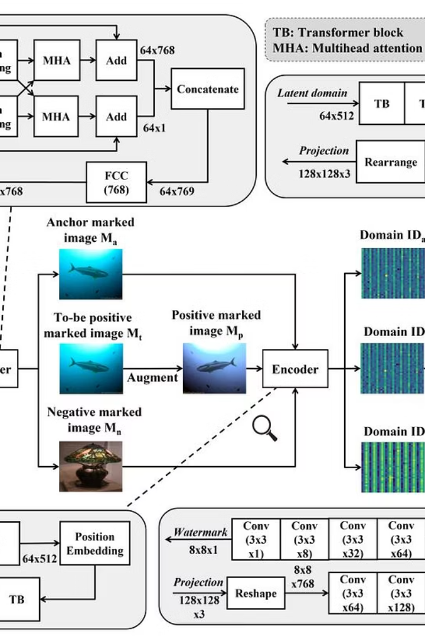
Architectural Components and Workflow
The proposed architecture consists of four main components: the embedder, encoder, decoder, and extractor, trained sequentially. The workflow involves inputting anchor, positive, and negative cover images and watermarks into the embedder to yield marked images.
These marked images are then fed into the encoder, producing invariant domains that abstract essential features and mitigate noise. The invariant domains are subsequently processed by the decoder and extractor to recover the watermarks, which should closely resemble the originals, demonstrating the scheme's robustness.

Slide 6
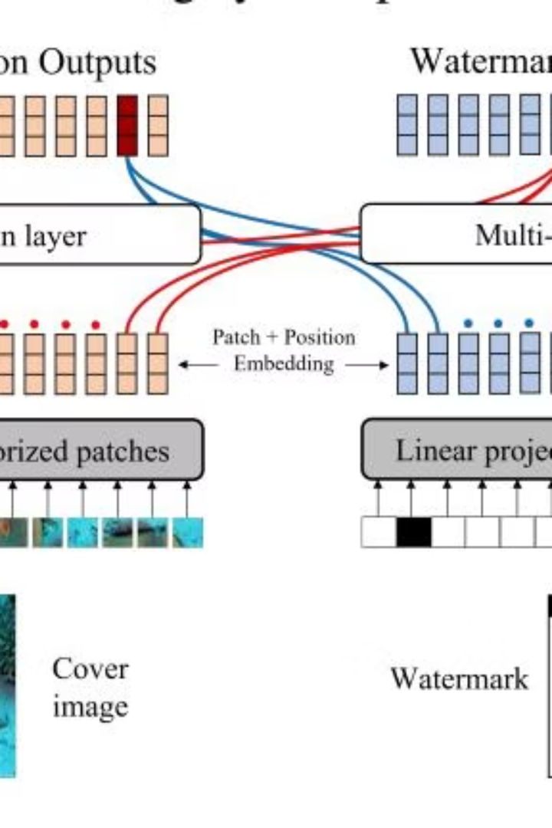
Benefits of Cross-Attention (MHA)
Global Context Capture
Information Exchange
Vision Transformers (ViTs) utilize a self-attention mechanism to efficiently capture global context among pixels, aiding in understanding spatial relationships within images. This contrasts with CNNs, which focus on local feature extraction.
Cross-attention facilitates information exchange between different sequences. We propose using Multi-Head Attention (MHA) in image watermarking to allocate watermarks across various regions based on relevance.
Robust and Imperceptible
By treating the watermark as auxiliary information and applying cross-attention between image and watermark embeddings, we aim for a more robust and imperceptible watermarking process. This approach identifies optimal embedding locations.

Slide 7
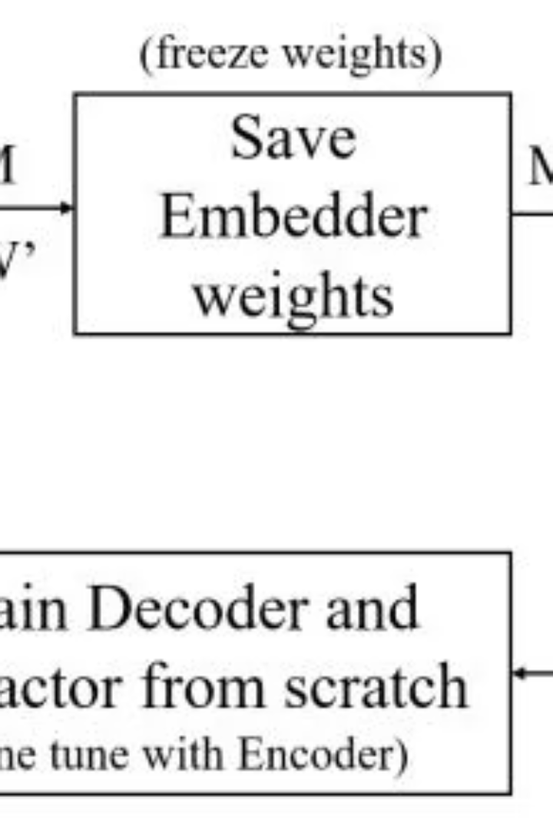
The Invariant Domain and Training Scheme
The invariant domain aims to encapsulate essential patterns and salient details from the marked image, serving as a robust anchor for watermark embedding and ensuring resilience against distortions. This allows for robust watermark extraction even amidst heavy distortions.
Our proposed method learns this invariant domain by minimizing the distance between encodings of anchor and positive marked images, while maximizing the distance from negative marked images. This self-supervised training scheme simultaneously learns watermarking and the invariant domain from scratch.

Slide 8
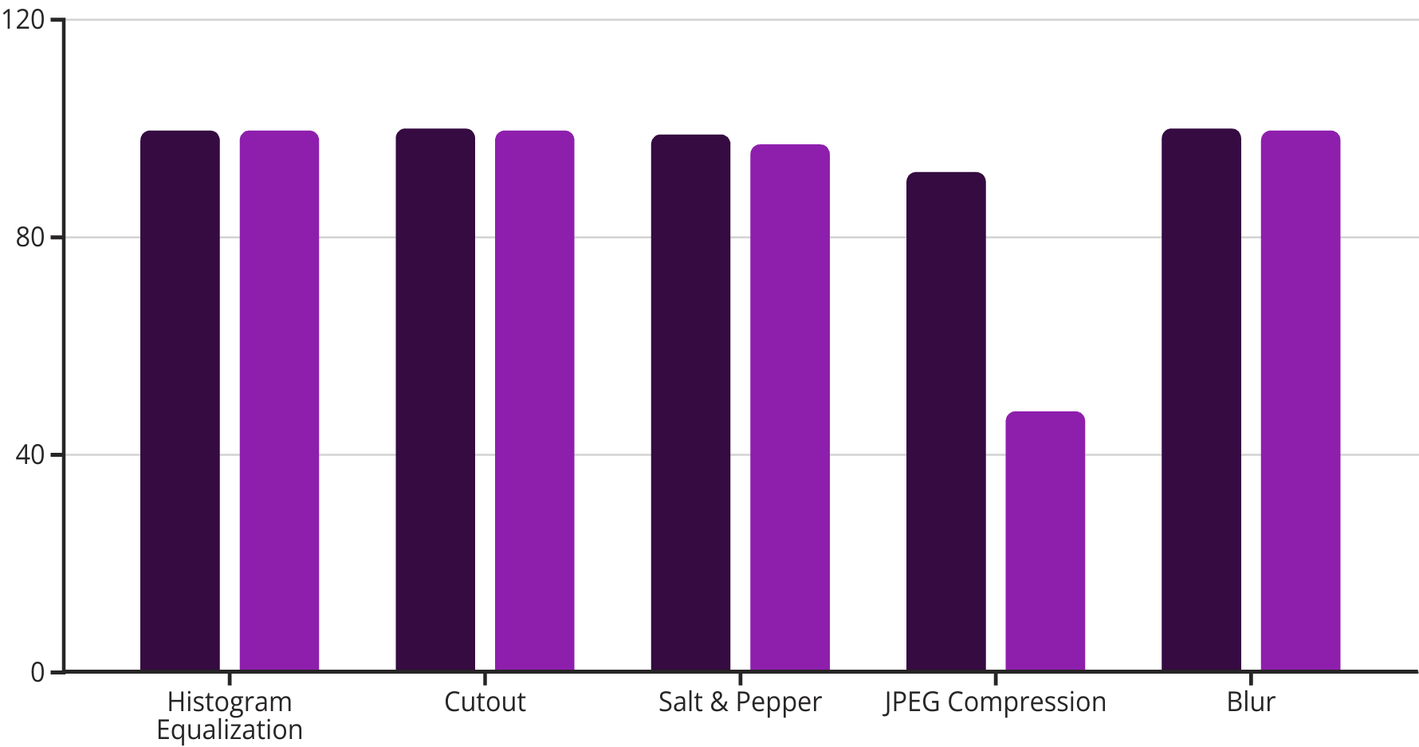
Experimental Results and Comparative Analysis
BRR% [14]
BRR% Ours
Our scheme demonstrates strong robustness against various noise types, particularly brightness, contrast, hue, histogram equalization, cutout, and Salt & Pepper manipulations. While there's a performance dip in JPEG compression, possibly due to ViT integration, overall, our method matches or outperforms state-of-the-art techniques.

